Slide 1
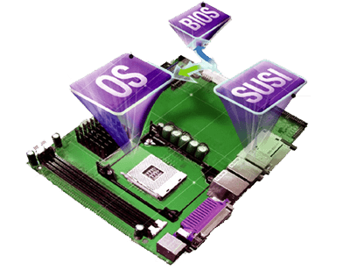
Seminar On Embedded Systems
Submitted to Submitted by:
Dr. Shaid mehraj shah M. Srinuvasarao
E&C-122/16
7th semester, NIT Srinagar

Slide 2
Content
What are embedded system
Components
Tool chain for embedded software
Challenges
Application
Future Trends
Conclusion

Slide 3
WHAT ARE EMBEDDED SYSTEMS ?
An embedded system is a special purpose computer that is used inside of a device.
A Combination of hardware and software that forms the components of a larger systems.

Slide 4
COMPONENTS OF AN EMBEDDED SYSTEMS
Embedded hardware :-It mainly consists of a microcontroller with various peripheral IC’s.
Embedded RTO’S :-All intelligent devices that perform complex functions have an embedded operating system inside.
Device drivers :-The software that acts as a glue between the operating system and the peripheral device is called the device driver.
Communication stacks :-If the embedded device is capable of communicating to the external world, it has a communication software stack running on the top of operating system.
Embedded application :-It performs the predefined function of the embedded device.

Slide 5
TOOL CHAIN FOR EMBEDDED SOFTWARE
C & C++ FILES
ASSEMBLY FILES (TARGET ASSEMBLY LANGUAGE)
CROSS COMPILER
CROSS ASSEMBLER
OBJECT FILE (MAYBE ANY FORMAT)
OBJECT FILES (MAYBE ANY FORMAT)
Host
LINKER/ LOCATORS
EXECUTABLE FILE (OF ANY STANDARD FORMAT)
TARGET SYSTEM

Slide 6
CHALLENGES
Precise engineering and design.
Low in cost.
High performance.
Careful selection of chips.
Efficiency.
In short, the challenge is to provide affordable, highly integrated devices meeting stringent requirements for safety, security, reliability, availability and at the same time keeping the cost low.

Slide 7
APPLICATIONS
Automatic teller machines.
Cellular telephone and telephone switches.
Handheld calculators.
Household appliances including washing machine, television sets, microwave ovens, etc.
Multifunction wristwatches.
Medical equipment.
Programmable digital assistants (PDA’s).
Measurement equipments like oscilloscopes, logic analyzers and spectrum analyzers.
Programmable logic controllers (PLC’s).

Slide 8
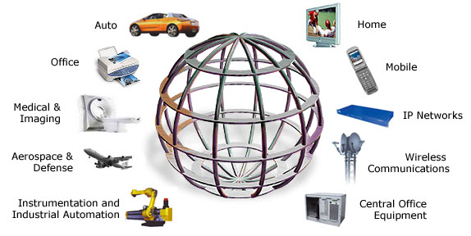
Embedded systems globe and areas

Slide 9
FUTURE TRENDS
Adaptive cruise control
Telemedicine
Security
Tele-matics
Bluetooth applications

Slide 10
CONCLUSION
The world of embedded systems is a dreamer’s paradise with unlimited possibilities.
It make controlling all the systems around just by a simple gesture and the things respond to you as if it was some magic.
As microprocessors are becoming smaller and cheaper, more and more products are becoming ‘smart’ with microprocessors embedded in them.

Slide 11
GitHub repository link

Slide 12
Thank you !

